Slide 1
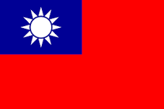
The Teas of Taiwan
Presentation to the Tea Guild of Canada
April 5, 2017

Slide 2
Laoshi Chen Huan-Tang

Slide 3
Marty Wu

Slide 4
Why Taiwan?
First and foremost, Taiwan produces some of the world’s greatest teas.

Slide 5
Why Taiwan?
First and foremost, Taiwan produces some of the world’s greatest teas.
Taiwan is at the cutting edge of tea research.

Slide 6
Why Taiwan?
First and foremost, Taiwan produces some of the world’s greatest teas.
Taiwan is at the cutting edge of tea research.
Taiwan is relatively unknown as a tea producer.

Slide 7
Why Taiwan?
First and foremost, Taiwan produces some of the world’s greatest teas.
Taiwan is at the cutting edge of tea research.
Taiwan is relatively unknown as a tea producer.
Taiwan is beautiful.

Slide 8
Why Taiwan?
First and foremost, Taiwan produces some of the world’s greatest teas.
Taiwan is at the cutting edge of tea research.
Taiwan is relatively unknown as a tea producer.
Taiwan is beautiful.
Several of my dearest friends are Taiwanese

Slide 9
Why Taiwan?
First and foremost, Taiwan produces some of the world’s greatest teas.
Taiwan is at the cutting edge of tea research.
Taiwan is relatively unknown as a tea producer.
Taiwan is beautiful.
Several of my dearest friends are Taiwanese
I love drinking Taiwanese tea!

Slide 10
Things we’ll cover
A short history of Taiwanese tea the tea industry.

Slide 11
Things we’ll cover
A short history of Taiwanese tea and tea industry.
Taiwanese tea cultivars

Slide 12
Things we’ll cover
A short history of Taiwanese tea and tea industry.
Taiwanese tea cultivars
Contemporary tea processing in Taiwan

Slide 13
Things we’ll cover
A short history of Taiwanese tea and tea industry.
Taiwanese tea cultivars
Contemporary tea processing in Taiwan
Principal growing regions in Taiwan

Slide 14
Things we’ll cover
A short history of Taiwanese tea and tea industry.
Taiwanese tea cultivars
Contemporary tea processing in Taiwan
Principal growing regions in Taiwan
Tasting Taiwanese tea

Slide 15
Things we’ll cover
A short history of Taiwanese tea and tea industry.
Taiwanese tea cultivars
Contemporary tea processing in Taiwan
Principal growing regions in Taiwan
Tasting Taiwanese tea
Some Controversies
Seeds or Clones?

Slide 16
Things we’ll cover
A short history of Taiwanese tea and tea industry.
Taiwanese tea cultivars
Contemporary tea processing in Taiwan
Principal growing regions in Taiwan
Tasting Taiwanese tea
Some Controversies
Seeds or Clones?
Is TTES 18 (紅玉) a black tea or an oolong tea?

Slide 17
Things we’ll cover
A short history of Taiwanese tea and tea industry.
Taiwanese tea cultivars
Contemporary tea processing in Taiwan
Principal growing regions in Taiwan
Tasting Taiwanese tea
Some Controversies
Seeds or Clones?
Is TTES 18 (紅玉) a black tea or an oolong tea?
Questions

Slide 18
Taiwan

Slide 19
Taiwan always has had a problematic relationship with China

Slide 20
Taiwan always has had a problematic relationship with China
Earliest “government” was under the Dutch

Slide 21
Taiwan always has had a problematic relationship with China
Earliest “government” was under the Dutch
During Ming dynasty Taiwan was the “wild, wild east”

Slide 22
Taiwan always has had a problematic relationship with China
Earliest “government” was under the Dutch
During Ming dynasty Taiwan was the “wild, wild east”
At the fall of the Ming Taiwan became a haven for opponents of the Qing conquerors

Slide 23
Taiwan always has had a problematic relationship with China
Earliest “government” was under the Dutch
During Ming dynasty Taiwan was the “wild, wild east”
At the fall of the Ming Taiwan became a haven for opponents of the Qing conquerors
Qing assumed nominal control of Taiwan under the Kangxi Emperor

Slide 24
Taiwan always has had a problematic relationship with China
Earliest “government” was under the Dutch
During Ming dynasty Taiwan was the “wild, wild east”
At the fall of the Ming Taiwan became a haven for opponents of the Qing conquerors
Qing assumed nominal control of Taiwan under the Kangxi Emperor
Under the Qing, Taiwan officially was part of Fujian Province but there was little real control

Slide 25
The Early History of Tea and the Tea Trade in Formosa 1800 - 1895

Slide 26
Although tea plants and seeds had been taken to Taiwan much earlier, around 1810 occasional shipments of tea were made to Amoy

Slide 27
Although tea plants and seeds had been taken to Taiwan much earlier, around 1810 occasional shipments of tea were made to Amoy
By 1824 tea was being shipped to the mainland in considerable quantities

Slide 28
Although tea plants and seeds had been taken to Taiwan much earlier, around 1810 occasional shipments of tea were made to Amoy
By 1824 tea was being shipped to the mainland in considerable quantities
1861 Robert Swinhoe, first British consul in Taiwan brought these shipments to the attention of his government

Slide 29
Although tea plants and seeds had been taken to Taiwan much earlier, around 1810 occasional shipments of tea were made to Amoy
By 1824 tea was being shipped to the mainland in considerable quantities
1861 Robert Swinhoe, first British consul in Taiwan brought these shipments to the attention of his government
Following the Opium Wars, tea industry opened in India.

Slide 30
Although tea plants and seeds had been taken to Taiwan much earlier, around 1810 occasional shipments of tea were made to Amoy
By 1824 tea was being shipped to the mainland in considerable quantities
1861 Robert Swinhoe, first British consul in Taiwan brought these shipments to the attention of his government
Following the Opium Wars, tea industry opened in India.
The Chinese tea industry began a long decline from which it is only now fully recovering

Slide 31
Although tea plants and seeds had been taken to Taiwan much earlier, around 1810 occasional shipments of tea were made to Amoy
By 1824 tea was being shipped to the mainland in considerable quantities
1861 Robert Swinhoe, first British consul in Taiwan brought these shipments to the attention of his government
Following the Opium Wars, tea industry opened in India.
The Chinese tea industry began a long decline from which it is only now fully recovering
Taiwan benefited from the problems in China

Slide 32
Chinese Opium Den

Slide 33
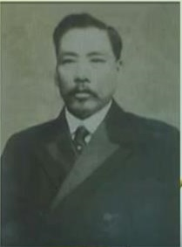
John Dodd and Li Chungsheng
John Dodd arrived in Taiwan in 1864 to explore the camphor trade
John Dodd
Li Chungsheng

Slide 34
John Dodd and Li Chungsheng
John Dodd arrived in Taiwan in 1864 to explore the camphor trade
1865 Dodd visited tea farmers in the Tamsui district
John Dodd
Li Chungsheng

Slide 35
John Dodd and Li Chungsheng
John Dodd arrived in Taiwan in 1864 to explore the camphor trade
1865 Dodd visited tea farmers in the Tamsui district
Dodd hired Li Chungsheng, from Amoy, as his comprador
John Dodd
Li Chungsheng

Slide 36
John Dodd and Li Chungsheng
John Dodd arrived in Taiwan in 1864 to explore the camphor trade
1865 Dodd visited tea farmers in the Tamsui district
Dodd hired Li Chungsheng, from Amoy, as his comprador
Li supervised system of making loans from Amoy capitalists to tea farmers to encourage production and expansion of plantings
John Dodd
Li Chungsheng

Slide 37
John Dodd and Li Chungsheng
John Dodd arrived in Taiwan in 1864 to explore the camphor trade
1865 Dodd visited tea farmers in the Tamsui district
Dodd hired Li Chungsheng, from Amoy, as his comprador
Li supervised system of making loans from Amoy capitalists to tea farmers to encourage production and expansion of plantings
1867 Dodd made trial shipment to Macao
John Dodd
Li Chungsheng

Slide 38
John Dodd and Li Chungsheng
John Dodd arrived in Taiwan in 1864 to explore the camphor trade
1865 Dodd visited tea farmers in the Tamsui district
Dodd hired Li Chungsheng, from Amoy, as his comprador
Li supervised system of making loans from Amoy capitalists to tea farmers to encourage production and expansion of plantings
1867 Dodd made trial shipment to Macao
1868 Dodd began firing leaf in Taiwan
John Dodd
Li Chungsheng

Slide 39
John Dodd and Li Chungsheng
John Dodd arrived in Taiwan in 1864 to explore the camphor trade
1865 Dodd visited tea farmers in the Tamsui district
Dodd hired Li Chungsheng, from Amoy, as his comprador
Li supervised system of making loans from Amoy capitalists to tea farmers to encourage production and expansion of plantings
1867 Dodd made trial shipment to Macao
1868 Dodd began firing leaf in Taiwan
1869 Dodd made trial shipment to New York
John Dodd
Li Chungsheng

Slide 40
John Dodd and Li Chungsheng
John Dodd arrived in Taiwan in 1864 to explore the camphor trade
1865 Dodd visited tea farmers in the Tamsui district
Dodd hired Li Chungsheng, from Amoy, as his comprador
Li supervised system of making loans from Amoy capitalists to tea farmers to encourage production and expansion of plantings
1867 Dodd made trial shipment to Macao
1868 Dodd began firing leaf in Taiwan
1869 Dodd made trial shipment to New York
From this beginning the trade grew dramatically
John Dodd
Li Chungsheng

Slide 41
Exports from Taiwan 1865 – 1885
Source: Gardella, Robert Harvesting Mountains: Fujian and the China Tea Trade (Berkeley, University of California Press 1994) p. 64.

Slide 42
Tea in the Colonial Period 1895 - 1945

Slide 43
In 1895 following Sino – Japanese war, Taiwan ceded to Japan.

Slide 44
In 1895 following Sino – Japanese war, Taiwan ceded to Japan.
Japanese encouraged the making of black tea to satisfy the Japanese market, to avoid competition with Japanese green tea and in response to the growth of Indian and Ceylonese trade

Slide 45
In 1895 following Sino – Japanese war, Taiwan ceded to Japan.
Japanese encouraged the making of black tea to satisfy the Japanese market, to avoid competition with Japanese green tea and in response to the growth of Indian and Ceylonese trade
Japanese invested in infrastructure. Opened Keelung harbor. Build railways.

Slide 46
In 1895 following Sino – Japanese war, Taiwan ceded to Japan.
Japanese encouraged the making of black tea to satisfy the Japanese market, to avoid competition with Japanese green tea and in response to the growth of Indian and Ceylonese trade
Japanese invested in infrastructure. Opened Keelung harbor. Build railways.
Created tea research stations in Taiwan, the first at Pingchen (Taoyuan) in 1909

Slide 47
The Japanese Establish the First Tea Research Stations
Yuchih Branch of TTES at Sun Moon Lake est. 1936

Slide 48
The Current TRES Headquarters in Taoyuan

Slide 49
Taiwanese Tea Growing Areas During the Colonial Era

Slide 50
WW II
Taiwan, a colony of Japan saw its tea trade drop precipitously

Slide 51
Tea in the Marshal Law Era 1945 - 1987

Slide 52
Aftermath of WW II
At the conclusion of the Pacific War, administrative control of Taiwan was returned to China.

Slide 53
Aftermath of WW II
At the conclusion of the Pacific War, administrative control of Taiwan was returned to China.
Taiwan NOT reintegrated into Province of Fujian

Slide 54
Aftermath of WW II
At the conclusion of the Pacific War, administrative control of Taiwan was returned to China.
Taiwan NOT reintegrated into Province of Fujian
Taiwanese identity, which had been growing during Japanese period, developed rapidly during Nationalist rule. 228 Massacre

Slide 55
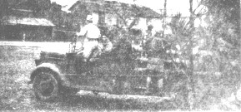
The 228 Massacre (二二八大屠殺)
Between 10,000 and 50,000 Taiwanese massacred in 1947

Slide 56
Aftermath of WW II
At the conclusion of the Pacific War, administrative control of Taiwan was returned to China.
Taiwan NOT reintegrated into Province of Fujian
Taiwanese identity, which had been growing during Japanese period, developed rapidly during Nationalist rule. 228 Massacre
1949 – 2 million mainlanders flood into Taiwan with Chiang Kai-Shek’s Kuomintang army

Slide 57
Chinese Revolution
Access to China and Chinese tea completely cut off

Slide 58
Chinese Revolution
Access to China and Chinese tea completely cut off
Taiwan tried to fill much of the void

Slide 59
Chinese Revolution
Access to China and Chinese tea completely cut off
Taiwan tried to fill much of the void
Produced “replacements” for Chinese teas such as:
Biluochun
Longjing
Smoky Tarry
Etc.

Slide 60
Developments in Planting
1n 1967 Chiang sponsored the first high mountain planting at Da Yu Ling

Slide 61
Developments in Planting
1n 1967 Chiang sponsored the first high mountain planting at Da Yu Ling
The Chen tea garden took three years to plant and develop

Slide 62
Chiang Kai-Shek and High Mountain Tea

Slide 63
The Chen Tea Garden

Slide 64
Taiwan’s Response to the Opening of China
Focus on Oolong tea

Slide 65
Taiwan’s Response to the Opening of China
Focus on Oolong tea
Establish tea competitions

Slide 66
Taiwan’s Response to the Opening of China
Focus on Oolong tea
Establish tea competitions
Establish High Mountain tea gardens

Slide 67
Fushoushan Farm

Slide 68
The Planting of High Mountain Tea Da Yu Ling 2800 Metres

Slide 69
Taiwan’s Response to the Opening of China
Focus on Oolong tea
Establish tea competitions
Establish High Mountain tea gardens
Promotion of unique Taiwanese tea culture and ceremony

Slide 70
At Lugu Tea Farmer’s Association

Slide 71
Tea in Contemporary Taiwan

Slide 72
Taiwan’s Tea Farmers
Taiwan is now, as it always has been, a country with a multitude of growers and small gardens

Slide 73
Taiwan’s Tea Farmers
Taiwan is now, as it always has been, a country with a multitude of growers and small gardens
These tend to be small family run businesses

Slide 74
Taiwan’s Tea Farmers
Taiwan is now, as it always has been, a country with a multitude of growers and small gardens
These tend to be small family run businesses
The average size of a tea garden in Taiwan is approximately ½ hectare.

Slide 75
Taiwan’s Tea Farmers
Taiwan is now, as it always has been, a country with a multitude of growers and small gardens
These tend to be small family run businesses
The average size of a tea garden in Taiwan is approximately ½ hectare.
There are only about 30,000 growers in Taiwan today

Slide 76
Production
Production in 2004 of around 20,000 tonnes

Slide 77
Production
Production in 2004 of around 20,000 tonnes
Production in 2014 of around 15,000 tonnes

Slide 78
Production
Production in 2004 of around 20,000 tonnes
Production in 2014 of around 15,000 tonnes
However, loss of production is largely in poorer quality, less expensive tea

Slide 79
Production
Production in 2004 of around 20,000 tonnes
Production in 2014 of around 15,000 tonnes
However, loss of production is largely in poorer quality, less expensive tea
Taiwan continues to concentrate production on high quality, high value tea.

Slide 80
Production
Production in 2004 of around 20,000 tonnes
Production in 2014 of around 15,000 tonnes
However, loss of production is largely in poorer quality, less expensive tea
Taiwan continues to concentrate production on high quality, high value tea.
Taiwan consumes more tea than it produces and exports are a relatively low percentage of production.

Slide 81
Production
Production in 2004 of around 20,000 tonnes
Production in 2014 of around 15,000 tonnes
However, loss of production is largely in poorer quality, less expensive tea
Taiwan continues to concentrate production on high quality, high value tea.
Taiwan consumes more tea than it produces and exports are a relatively low percentage of production.
BEWARE OF COUNTERFEITS, especially at the lower end.

Slide 82
Taiwanese Tea Cultivars

Slide 83
Cultivar Board at TTES Tea Garden

Slide 84
TTES #12 – Jin Xuan

Slide 85
Qing Xin Oolong

Slide 86
When is an Oolong not an Oolong? Qing Cha (青茶) “Teal Tea”

Slide 87
Qing Xin Da Pan

Slide 88
Processing Tea in Taiwan

Slide 89
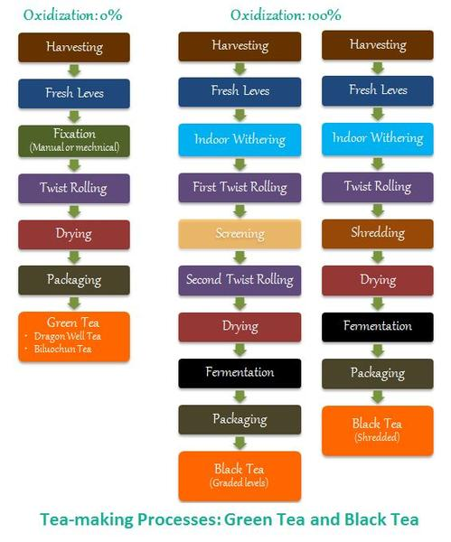

Slide 90
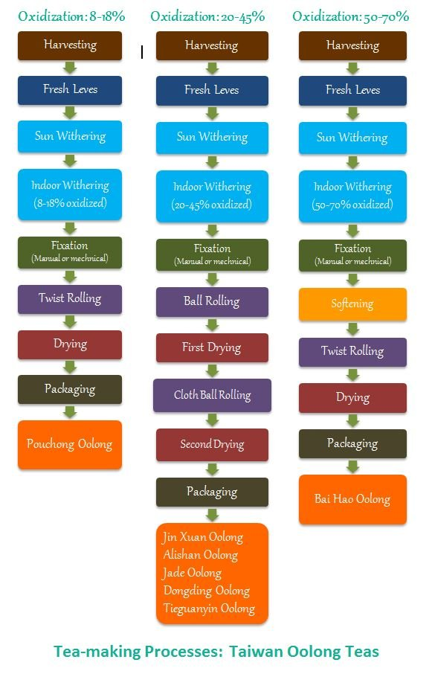

Slide 91
Plucking Bai Hao

Slide 92
Plucking Chingjin Gao Shan

Slide 93
Outdoor Withering

Slide 94
Indoor Withering

Slide 95
Bruising by Tumbling

Slide 96
Bruising by Shaking
Chen Jie Si (Jane) – Katie Yen’s daughter

Slide 97
Oxidation

Slide 98
Fixing

Slide 99
First Rolling

Slide 100
First Drying

Slide 101
Ball Rolling

Slide 102
Historic Method

Slide 103
Contemporary Method

Slide 104
Final Drying

Slide 105
Roasting

Slide 106
Taiwanese Tea Regions

Slide 108
Tea District Elevations

Slide 109
Old Growth Wild Trees

Slide 110
Lishan

Slide 111
Lalashan

Slide 112
Dong Ding Mountain

Slide 113
Pinglin (Wenshan)

Slide 114
Tasting Taiwanese Tea

Slide 115
Wenshan Bao Zhong

Slide 117
Plucking Master Wong’s Tea Garden

Slide 118
Wenshan Bao Zhong
Grower: Wong One Dashi
Culitvar: Qing Xin a.k.a. Oolong
Region: Pinglin, New Taipei City
Altitude: 700 m
Harvest: Winter 2016
Oxidation: 15%
Lightly Roasted

Slide 119
Chingjin High Mountain Organic Oolong

Slide 121
Katie’s Chingjin Tea Garden

Slide 122
Chingjin High Mountain Organic Oolong
Grower: Yen Ching-Yu (Katie)
Culitvar: Qing Xin a.k.a. Oolong
Region: Chingjin Mountain, Nantou County
Altitude: 1800 m
Harvest: Winter 2016
Oxidation: 20%
Unroasted

Slide 123
Alishan (Meishan District)

Slide 125
Lin Zhao-Huang’s Tea Garden

Slide 126
Alishan (Meishan District)
Grower: Lin Zhao-Huang
Culitvar: Qing Xin a.k.a. Oolong
Region: Alishan (Meishan District)
Altitude: 1100 m
Harvest: Winter 2016
Oxidation: 25%
Lightly Roasted

Slide 127
Bai Hao (Oriental Beauty)

Slide 129
Withering at Master Hsu’s Tea Factory

Slide 130
Bai Hao (Oriental Beauty)
Grower: Hsu Sheng-Fu Dashi
Culitvar: Qing Xin Da Pan
Region: Emai, Hsinchu
Altitude: 300 m
Harvest: Summer 2016
Oxidation: 70%
Roasted

Slide 131
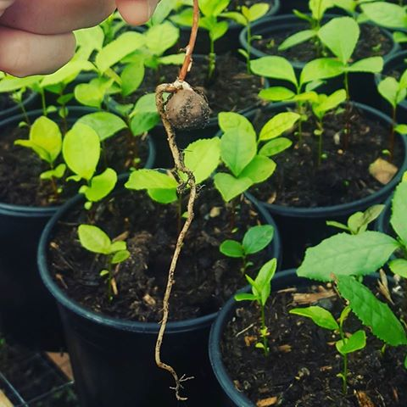
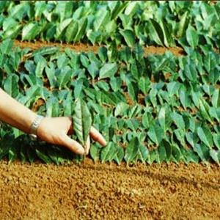
A couple of Controversies
1. Seed vs. cuttings – which yields better tea?

Slide 132
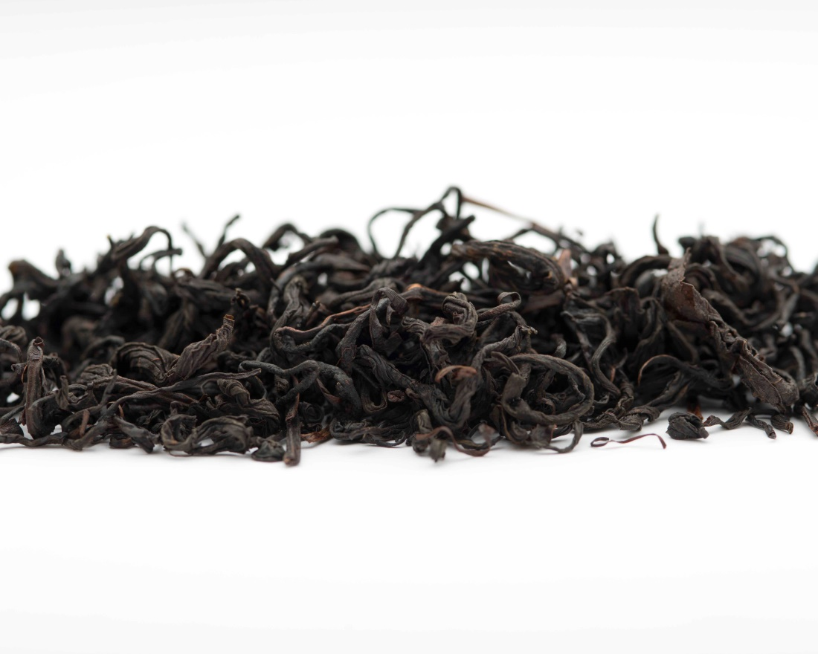
A couple of Controversies
2. Is TTES 18 (紅玉) a black tea or an oolong tea?

Slide 133
A couple of Controversies
2. Is TTES 18 (紅玉) a black tea or an oolong tea?
It is processed like a black tea

Slide 134
A couple of Controversies
2. Is TTES 18 (紅玉) a black tea or an oolong tea?
It is processed like a black tea
But it is only oxidized to around 90%

Slide 135
Questions?

Slide 136
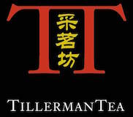
Thank you! www.tillermantea.net

